Slide 1
Report 1
Visit Code: https://github.com/Himasnhu-AT/Virtual-Internship---BA--DS

Slide 2
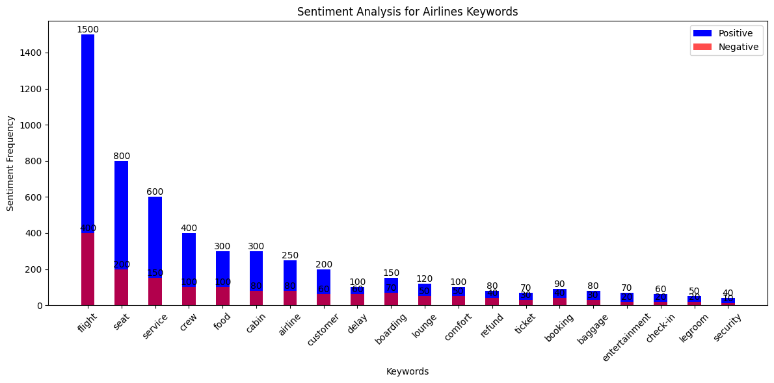
Sentiment Analysis Based on keywords

Slide 3
Topic 0: This topic discusses various aspects of flying with British Airways, including the seating arrangements, cabin space, meals, bedding, cabin crew, and arrival experience. It also mentions specific flights and airports such as Gatwick to Orlando, London to Frankfurt, and Venice to London City.
Topic 1: This topic focuses on the experience of flying with British Airways in Club Europe (business class). It mentions the service provided by the cabin crew, the availability of Wi-Fi, baggage handling, lounges, boarding process, meals, and overall standards.
Topic 2: This topic describes a negative experience with British Airways, particularly regarding flight delays, cancellations, and the ground handling at the airports. It mentions specific incidents at London Heathrow, waiting for luggage, lounge toilets, boarding, and lack of customer service.
Topic 3: This topic highlights a positive experience with British Airways, specifically in Club Europe. It mentions friendly and helpful staff, efficient check-in, comfortable seats, power ports, in-flight service, meals, and baggage handling. It also includes feedback on baggage handling at Heathrow.
Topic 4: This topic describes a frustrating experience with British Airways, focusing on a flight from London to Amsterdam. It mentions flight delays, airspace closures, cancellations, pilot and cabin crew communication, in-flight service, and ground handling. It also criticizes the handling of the situation by British Airways, including long queues, vouchers for sleeping on the floor, and difficulties with rebooking through the app.

Slide 4
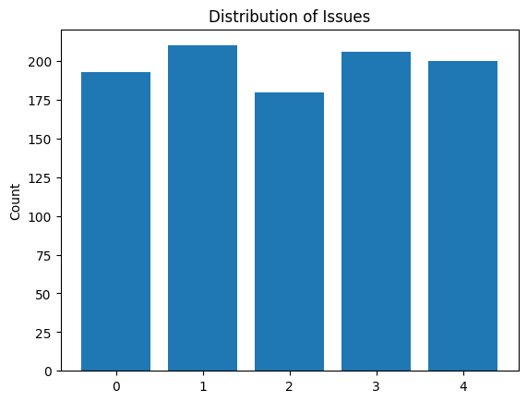
Issue Analysis

